Slide 1
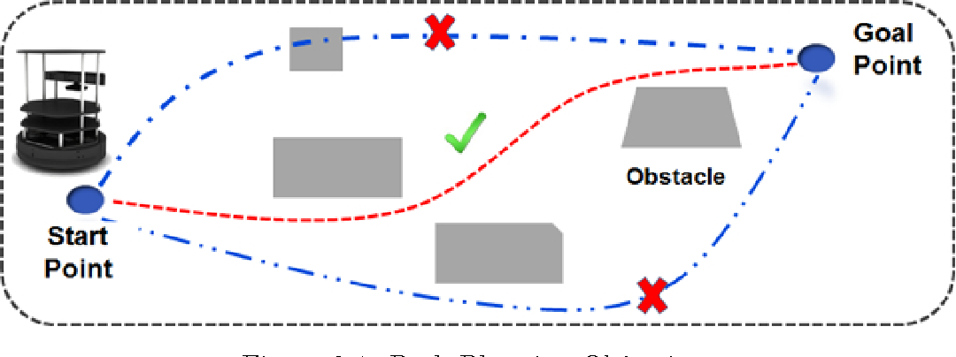
Extension of A*
Variable discretization
David Schwarze, Marvin Wieschollek

Slide 2
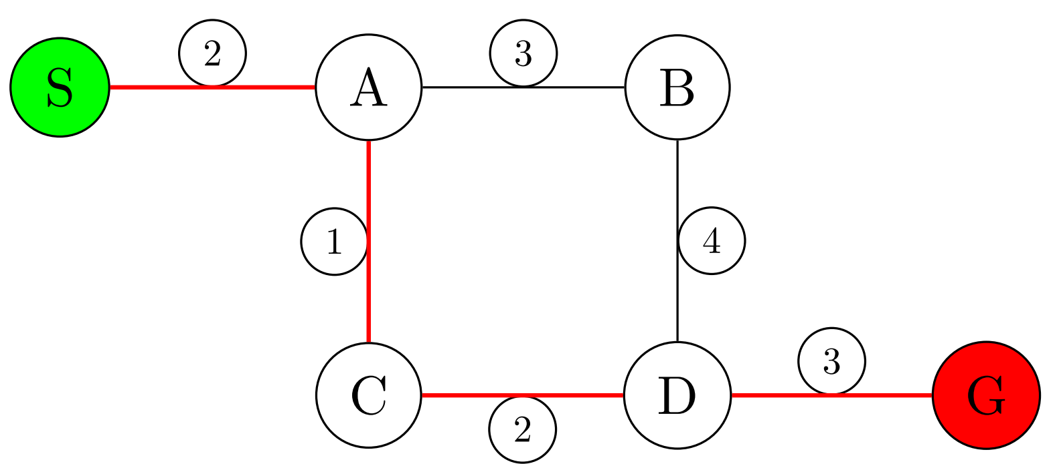

A*
Given a weighted graph, start node S and goal node G find the shortest path from S to G
Properties
Completeness
Optimality
Optimal Efficiency
b: branching factor
d: depth of the optimal solution
Notes:
Weighted graph , S , G and gives shortest path S to G
Popular

Slide 3
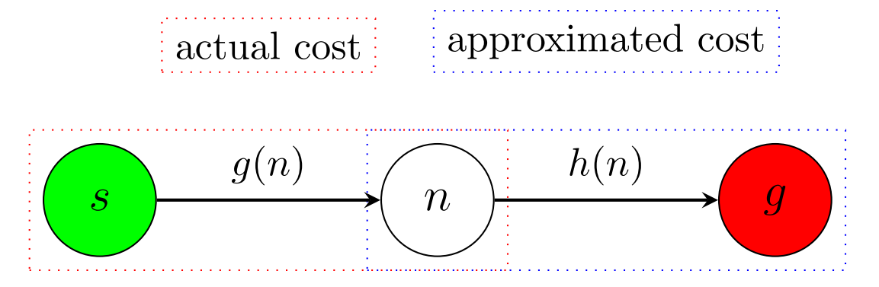
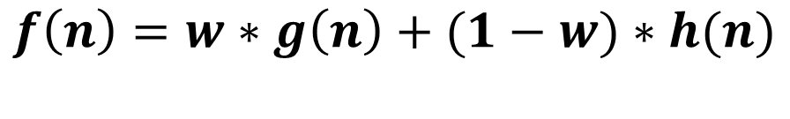

A* Algorithm
$$f\left(n\right)=w∗g\left(n\right)+(1−w)∗h(n)$$
Admissible: $h(n)≤h^{∗}(n)$
Consistent: $h(n)≤c(n,p)+h(p)$
f: total cost
g: exact cost from s to n
c(n, p): cost from n to p
h: estimated cost from n to g (heuristic)
h*: actual cost from n to g
p is the neighbor node of n
w: weight of heuristic and actual costs (0.5: standard, 0: Dijkstra)
Notes:
Admissible: Never overestimates the actual cost (lower bound) (we would miss out on some better paths we never explore)
Consistency: Ensures that once a node is explored we do not have to reopen it since alternative path will have a higher or equal cost)
Consistent: heuristic is always lower or equal than the costs of the node to it’s neighbor and the heuristic cost of the neighbor

Slide 4
A* Algorithm
Initialize Goal G, Start S, Graph, and Parameters
Add S to Graph
Repeat
Draw the current best node from the heap (current_node)
Check if the current_node is in collision --> GOTO 3
IsGoal(current_node) --> Collect and return the solution
Close node and add neighbors to Graph (HandleNode)
Calculate neighbors
Update for all neighbors n costs (f(n))
set the predecessor node and add to graph

Slide 5
Assignment: Extend A*
Parameterizable discretization for each joint/dimension
Case: Goal G and Start S not in the grid
Check for collisions along the path
Compare different discretization steps [10, 15, 25, 50, 100]
Compare results against lazy PRM and visual PRM

Slide 6
A* Algorithm
Initialize Goal, Start, Graph and Parameters, Initialize step_size
Add S to Graph
Discretize the initial goal and start nodes
Repeat
Draw current best node (current_node)
Check if point is in collision --> GOTO 4
IsGoal(current_node) --> Collect the return the solution
Close node and add neighbors to Graph (HandleNode)
Calculate neighbors
Update for all neighbors n costs (f(n))
set the predecessor node and add to graph

Slide 7
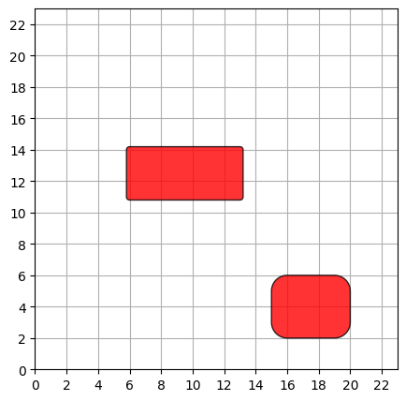
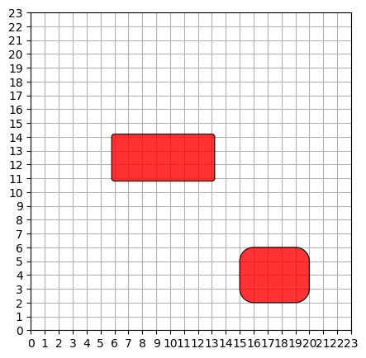
Assignment: Extension of A*
Parameterizable discretization

Slide 8
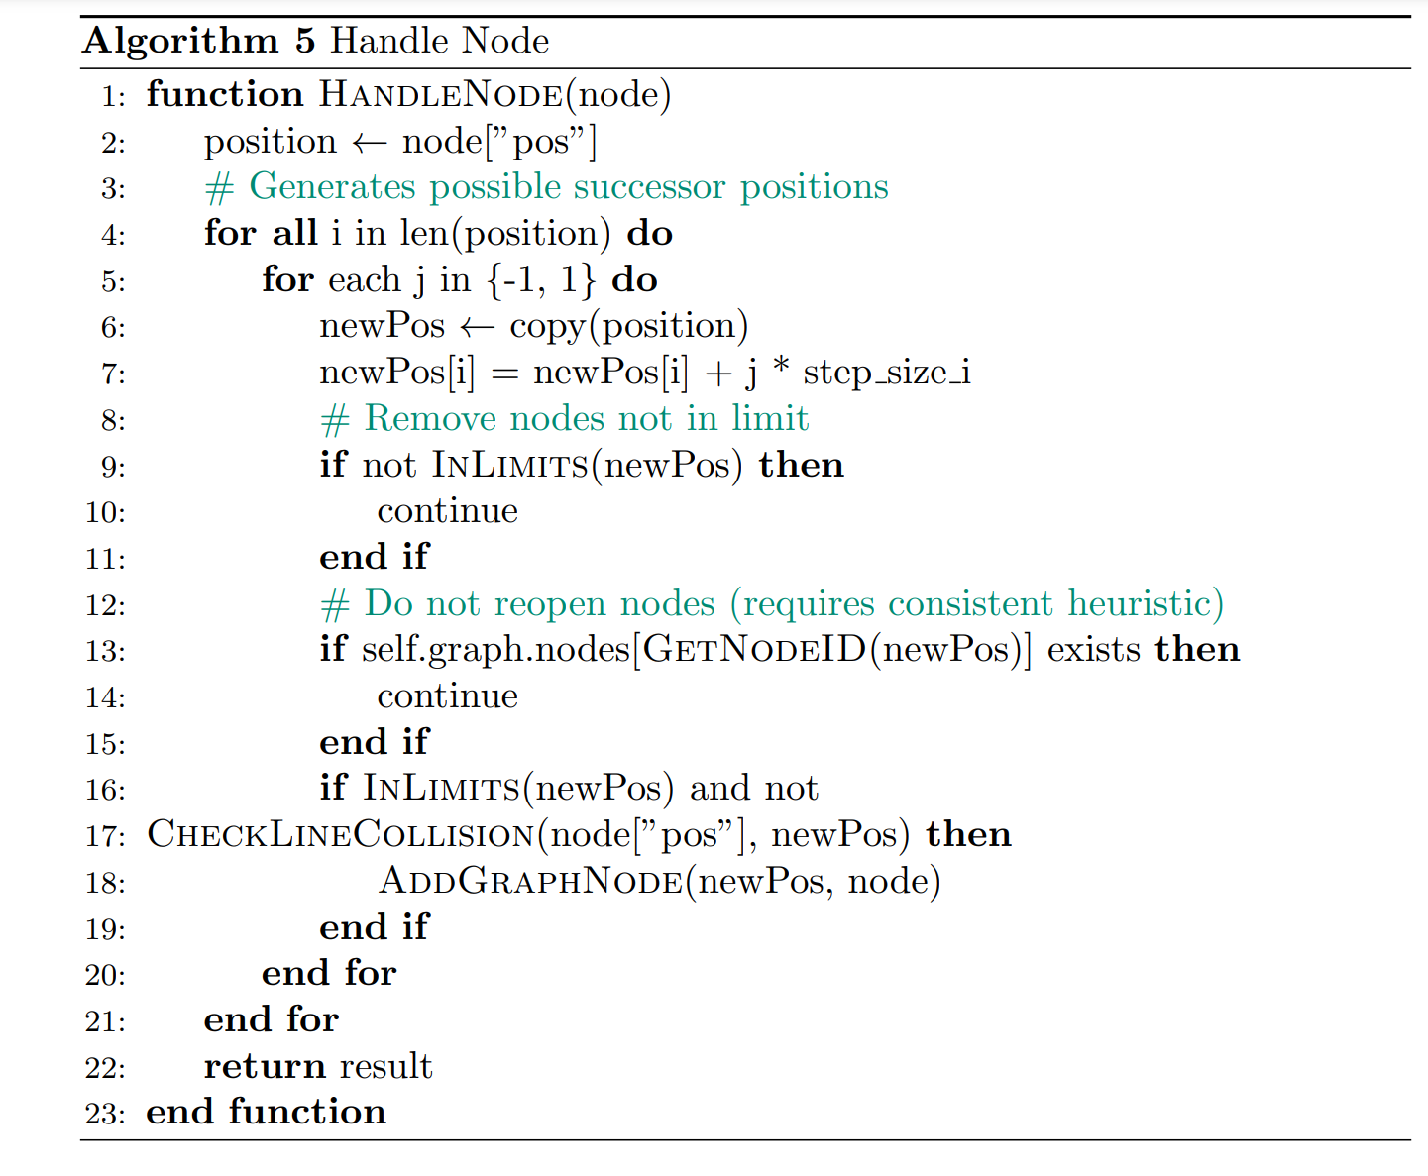
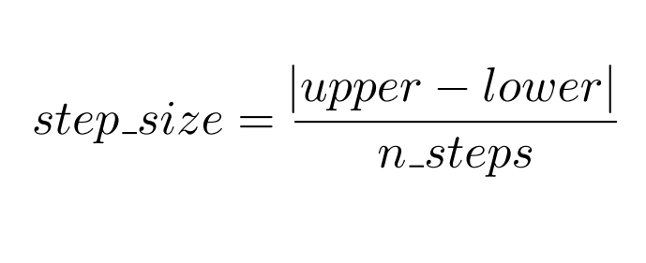
Assignment: Extension of A*
Parameterizable discretization

Slide 9
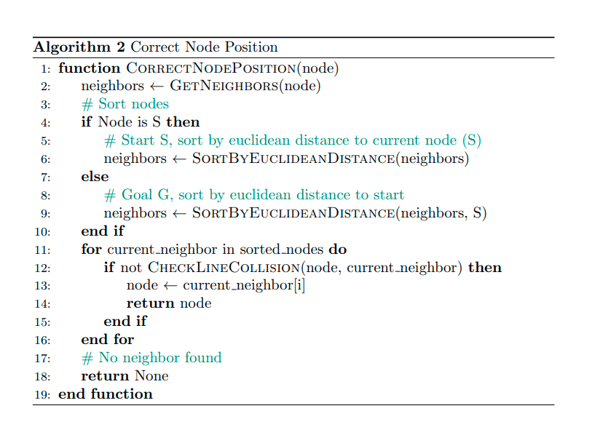
Assignment: Extension of A*
Outside grid nodes (Goal or Start)

Slide 10
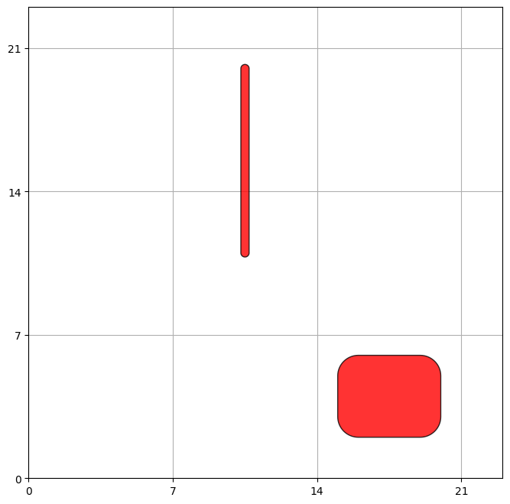
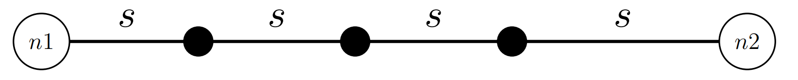
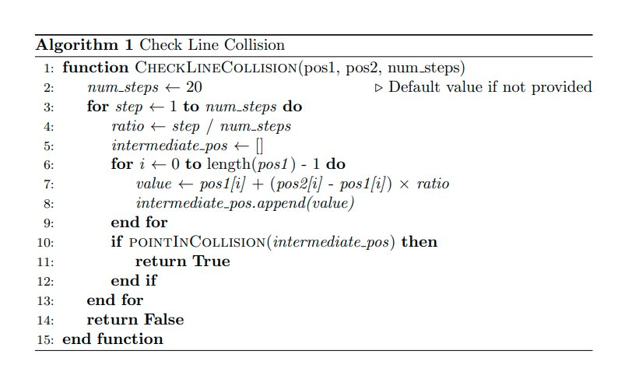
Assignment: Extension of A*
Path collision

Slide 11
Evaluation Setup
11 environments
Discretizations = [10, 15, 25, 30, 50, 100]
Metrics
Path length
Planning time
Roadmap size
Path distance (new)
Success rate (new)

Slide 12
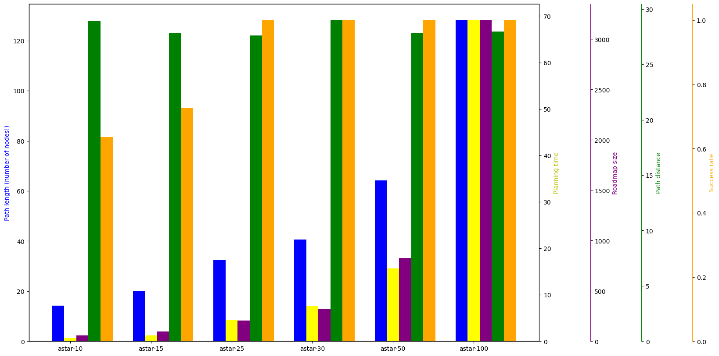
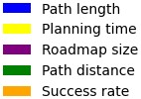
A* Discretization Comparision
Shorter paths with increasing costs

Slide 13
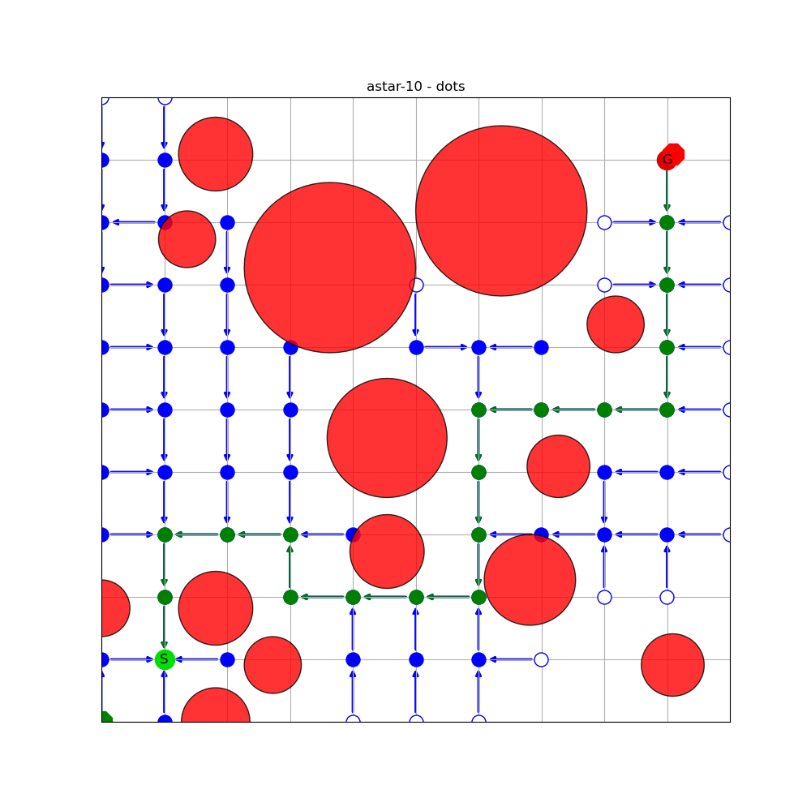
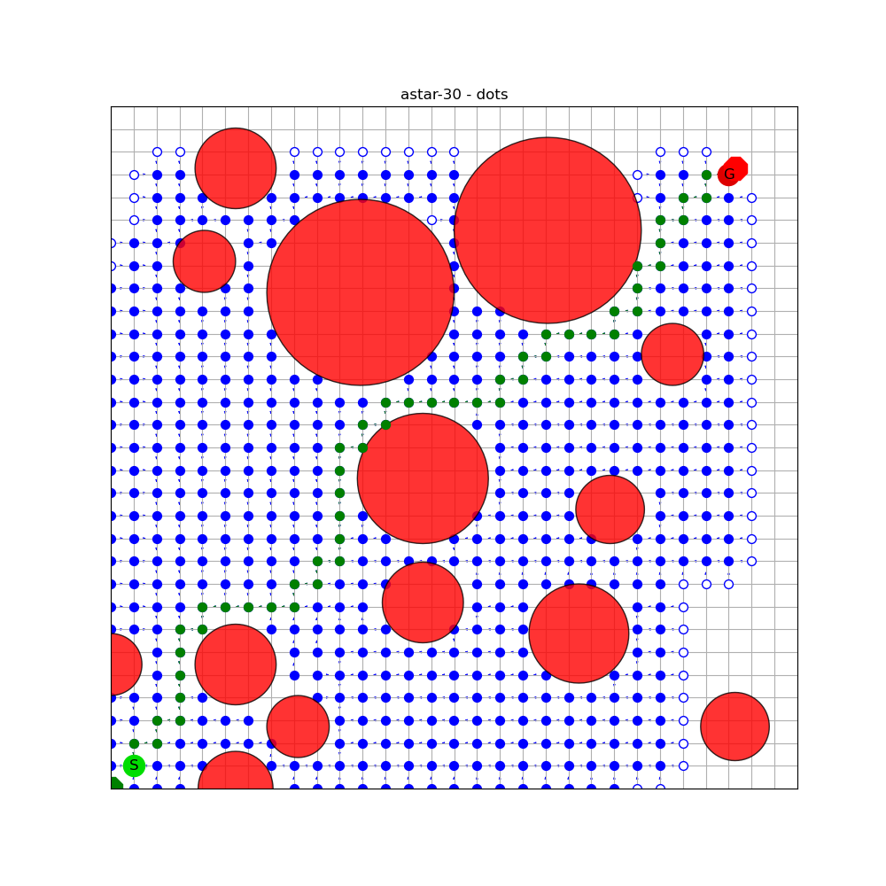
A* Discretization Comparision
Shorter paths with increasing costs
astar 10
astar 30

Slide 14
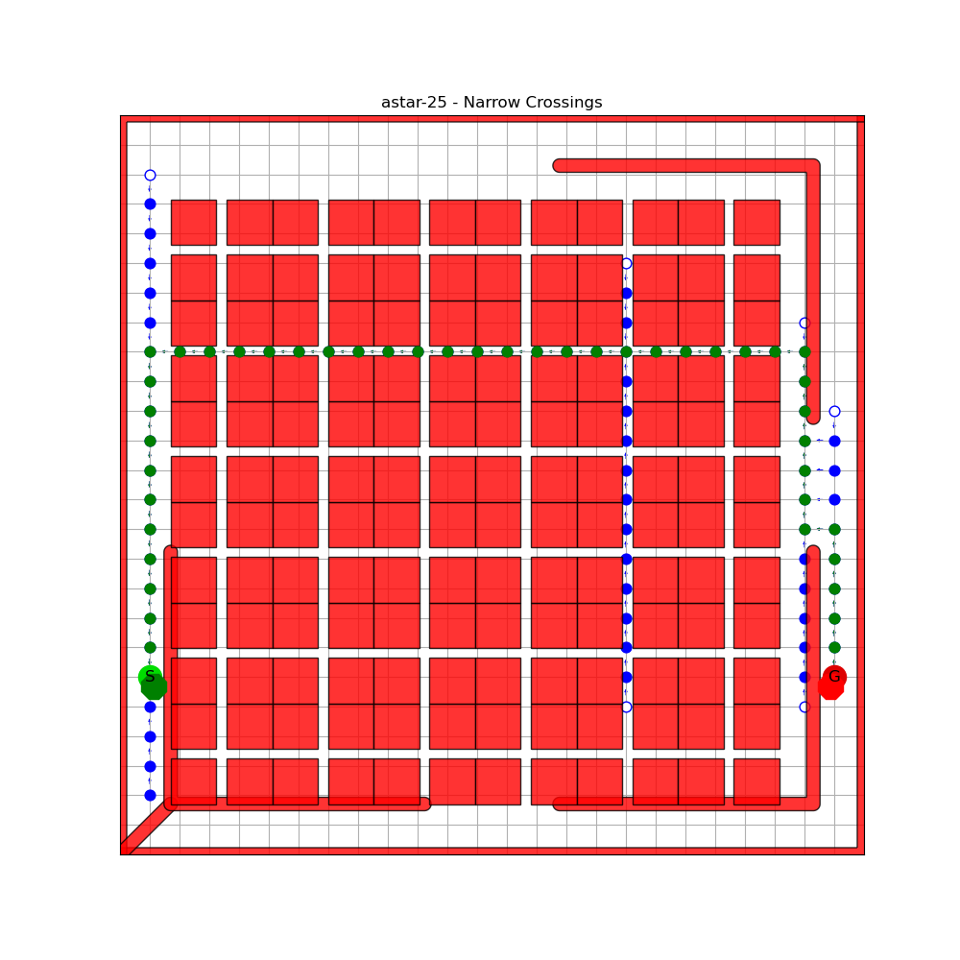
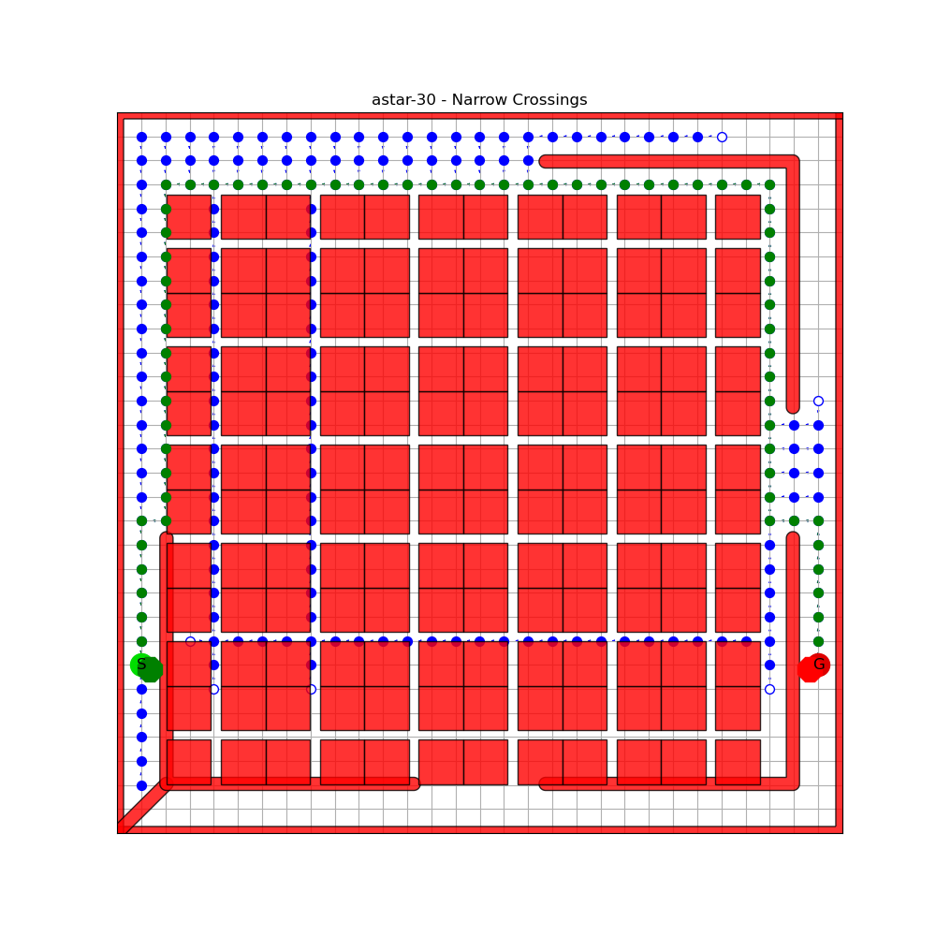
A* Discretization Comparision
Shorter paths with increasing costs
Environment depending
astar 25
astar 30

Slide 15
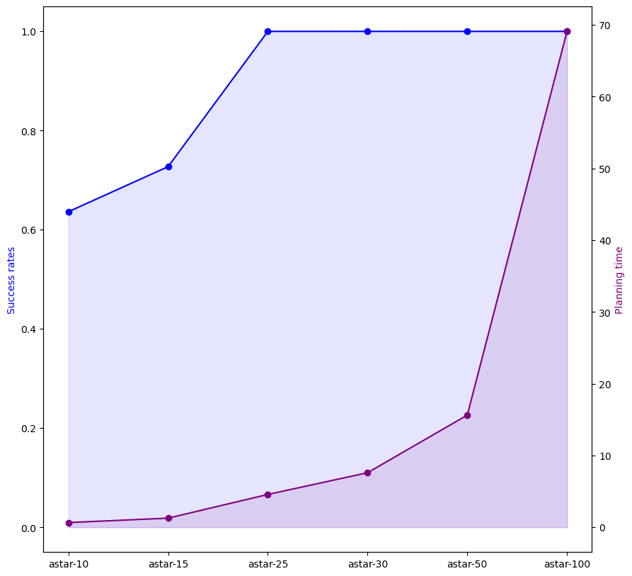

A* Discretization Comparision
Higher success rates with finer discretization
Modest discretization may be enough

Slide 16
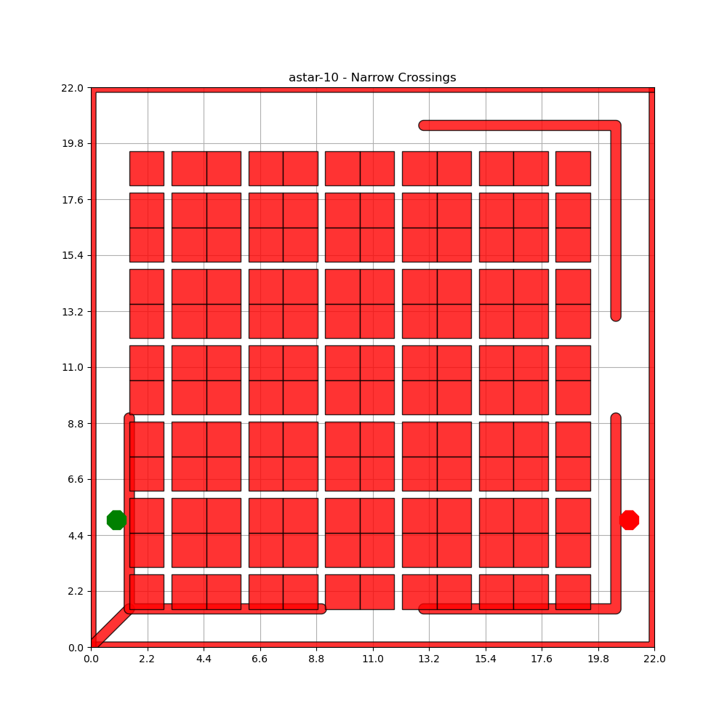
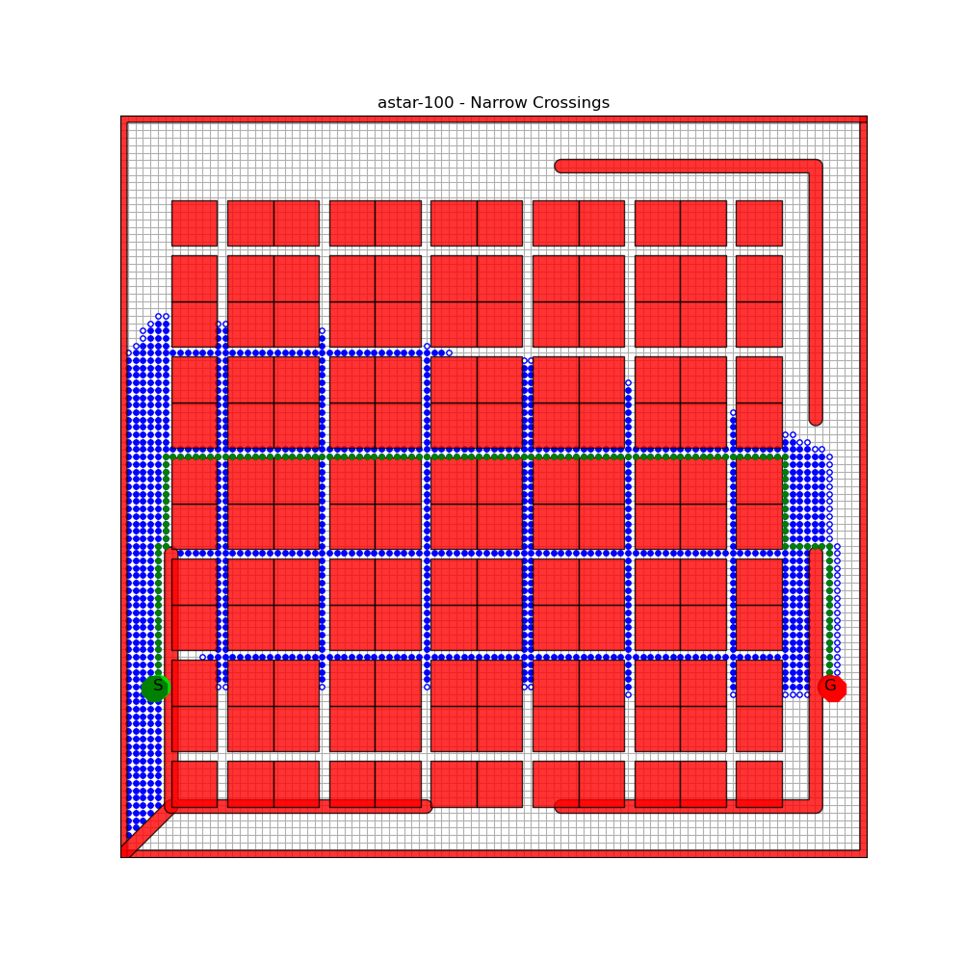
A* Discretization Comparision
Higher success rates with finer discretization
Modest discretization may be enough
astar 10
astar 100

Slide 17
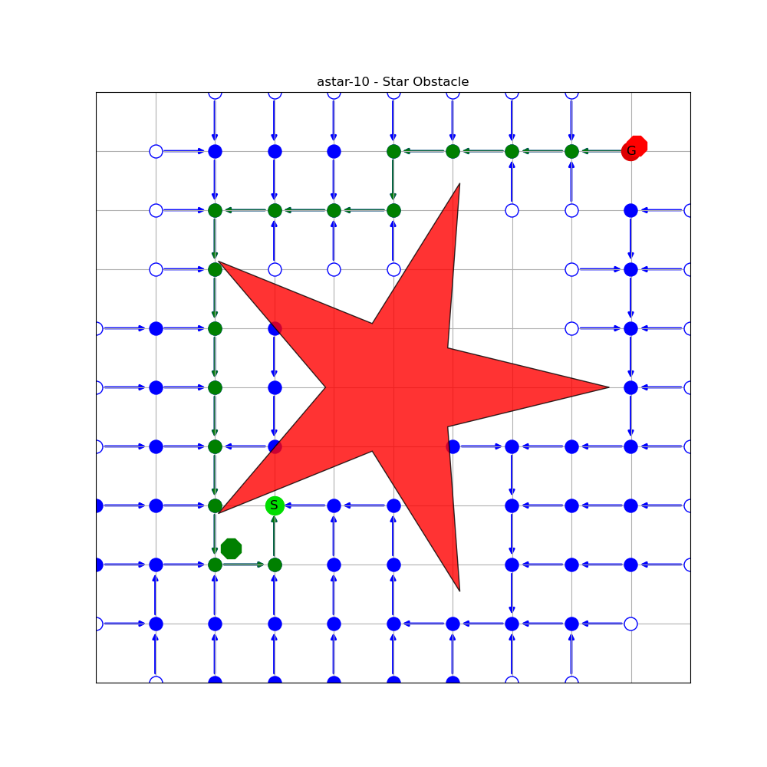
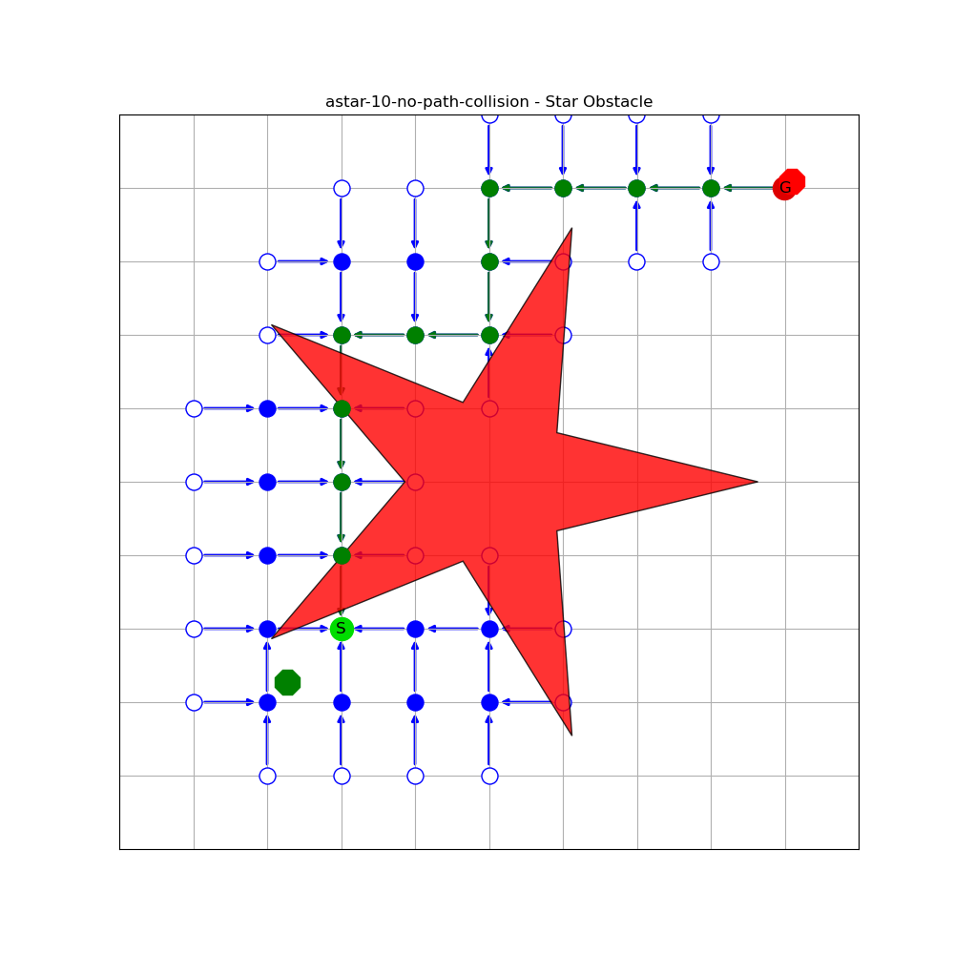
A* Collision Handling
Path collision
No path collision
astar 10
astar 10

Slide 18
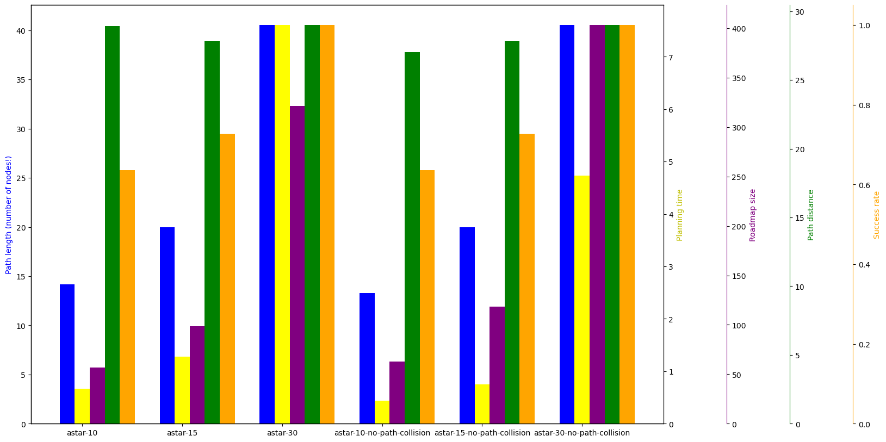
A* Collision Handling
With path collision
Without path collision
Shorter paths without path collision
Faster without path collision
BUT: Not correct

Slide 19
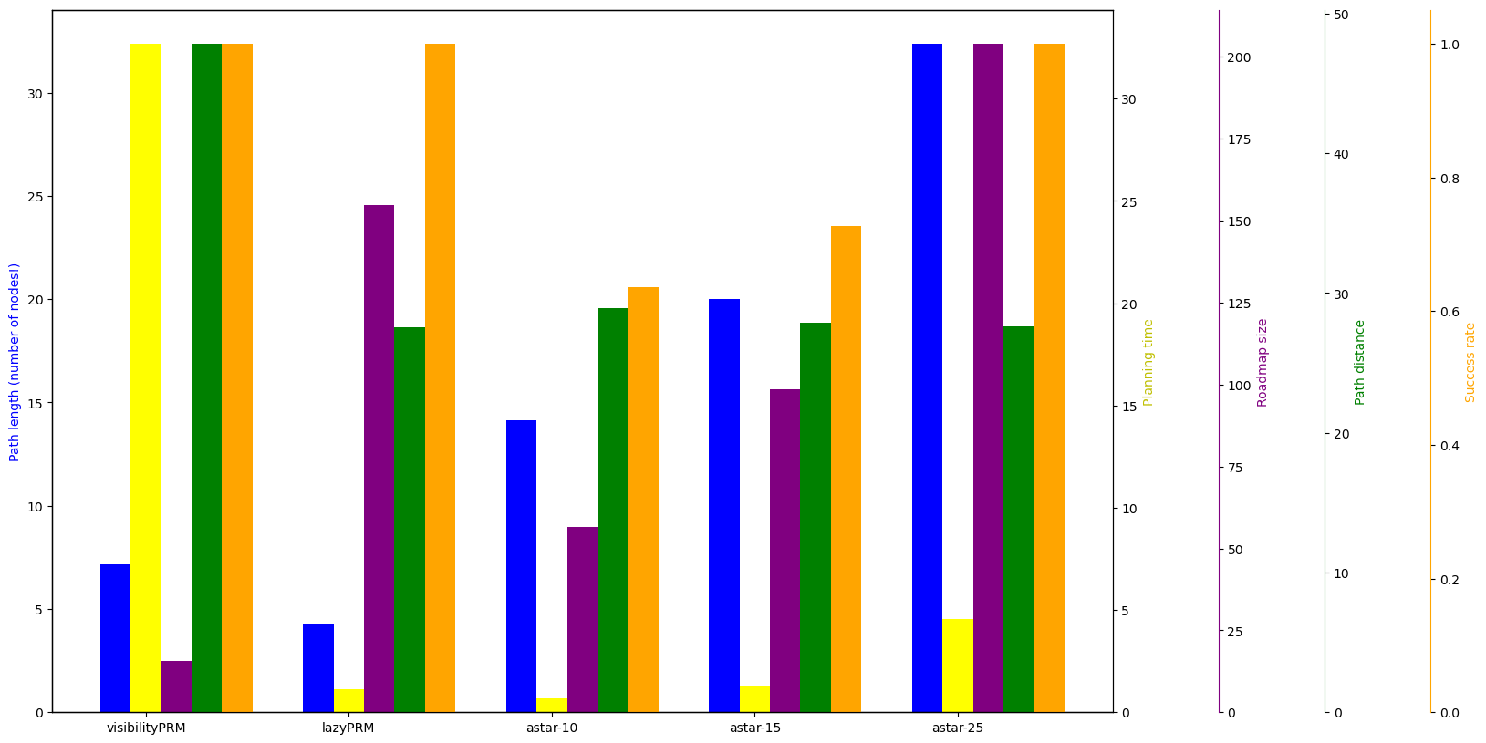
PRM vs A*
Visibility PRM not competitive
Lazy PRM
Fastest
Shortest paths
A*
Optimal discret path
Faster in suitable environments

Slide 20
Summary
Key facts
Improvements
Higher success
Better paths
More time consuming
Adaptive grid

Slide 21
Backup Slides

Slide 22
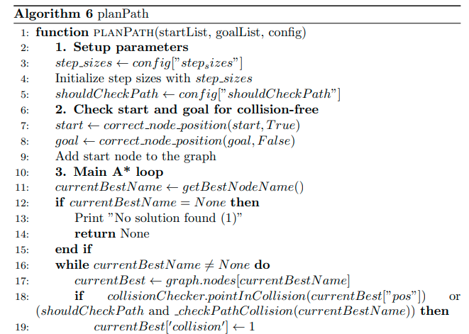
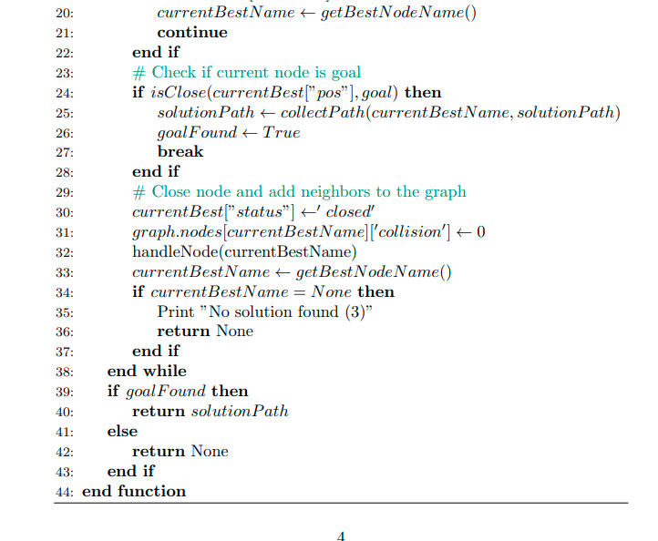
A* Extended Algorithm

Slide 23
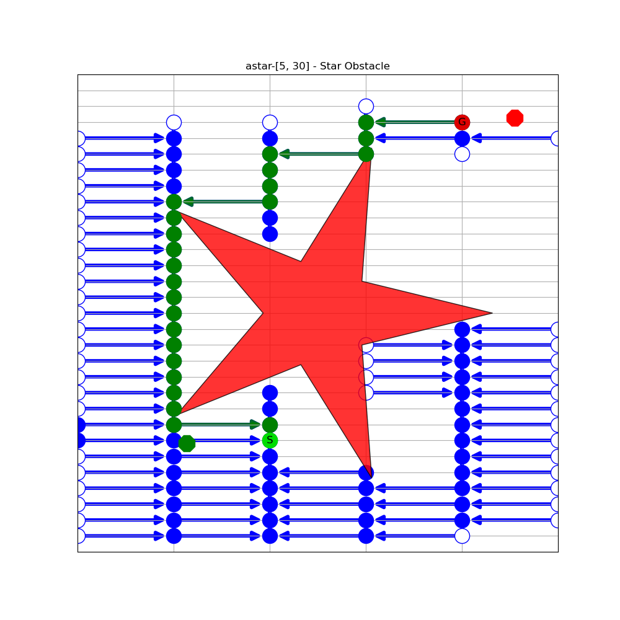
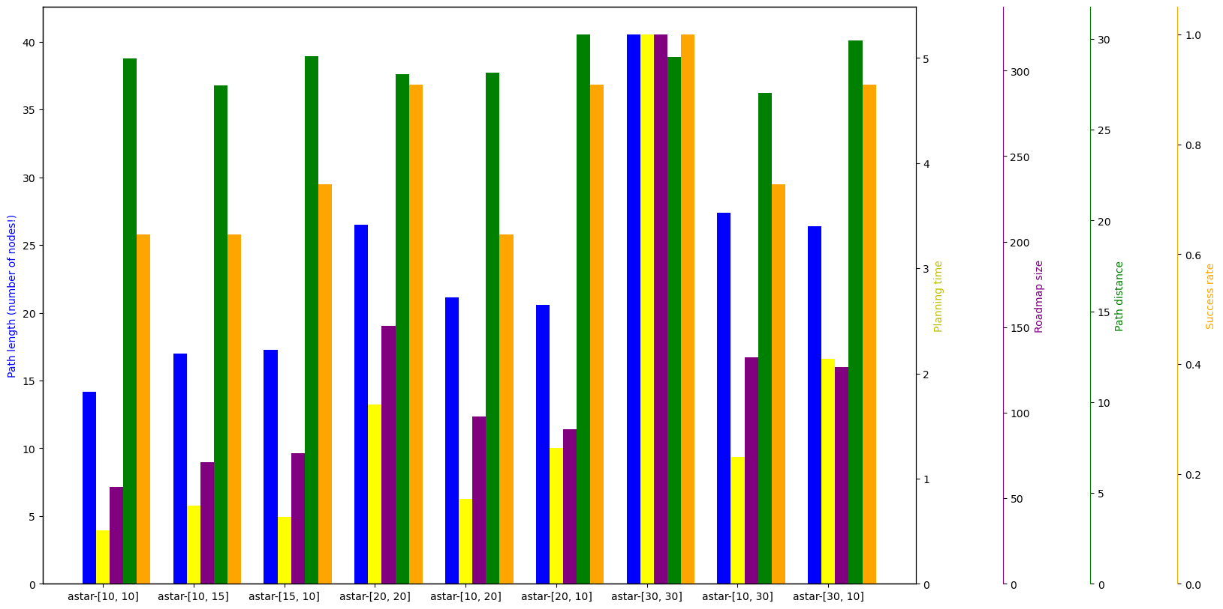
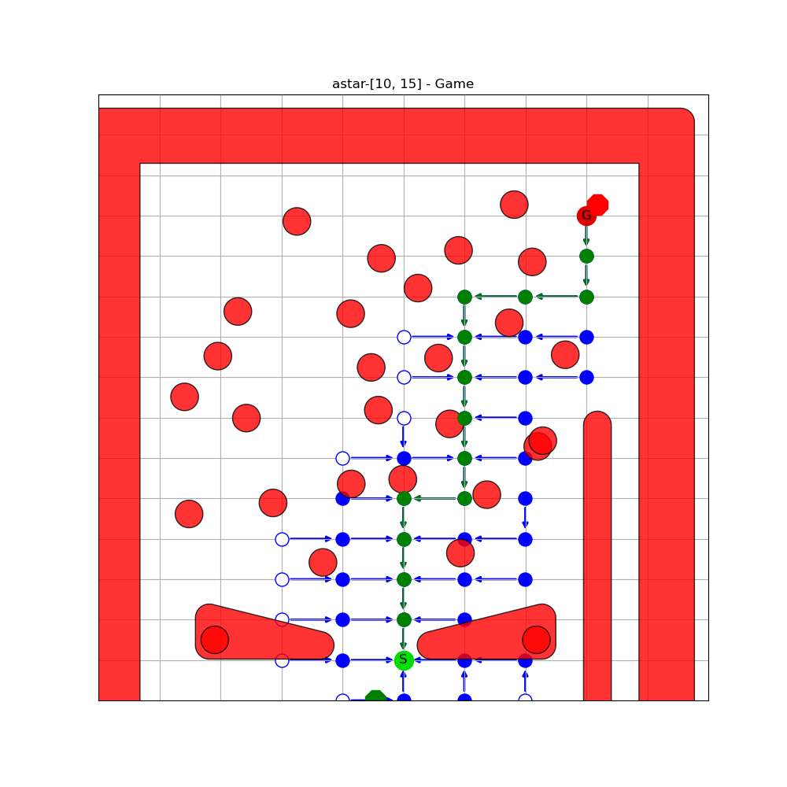
Different step sizes

Slide 24
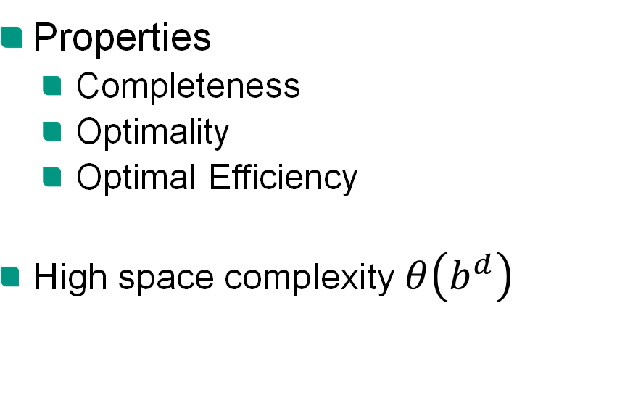
A*
Given a weighted graph, start node S and goal node G find the shortest path from S to G
Properties
Completeness
Optimality
Optimal Efficiency
High space complexity$θ\left(b^{d}\right)$
b: branching factor
d: depth of the optimal solution
Notes:
Weighted graph , S , G and gives shortest path S to G
Popular

Slide 25
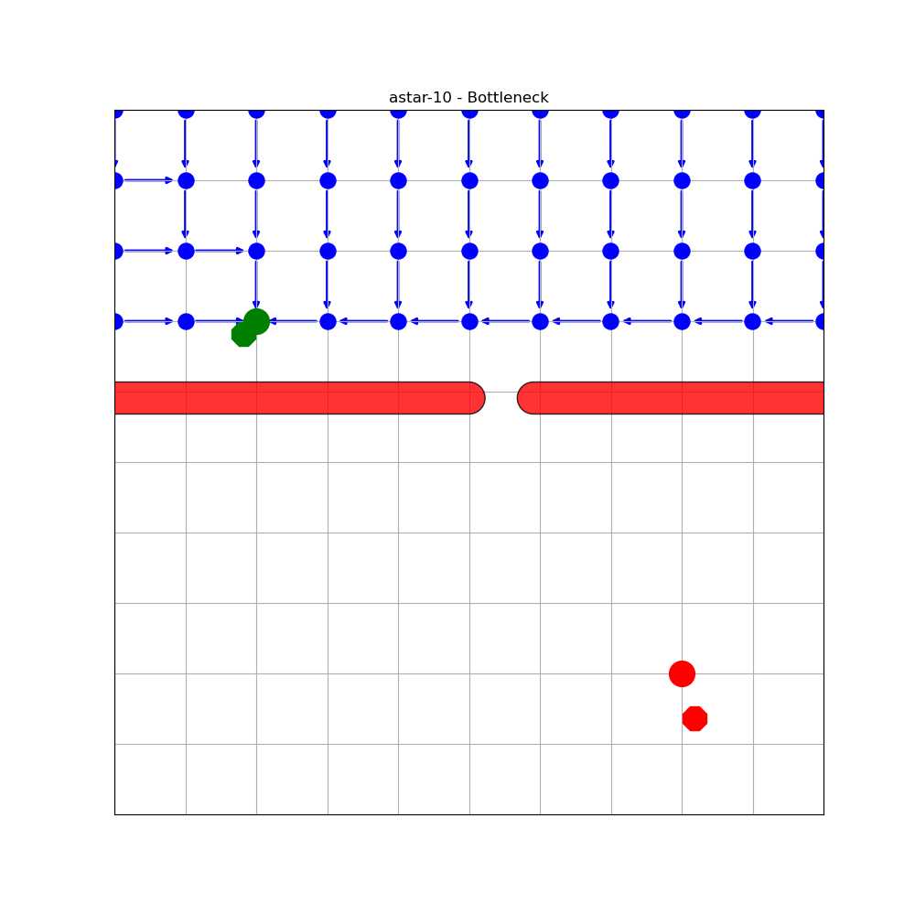
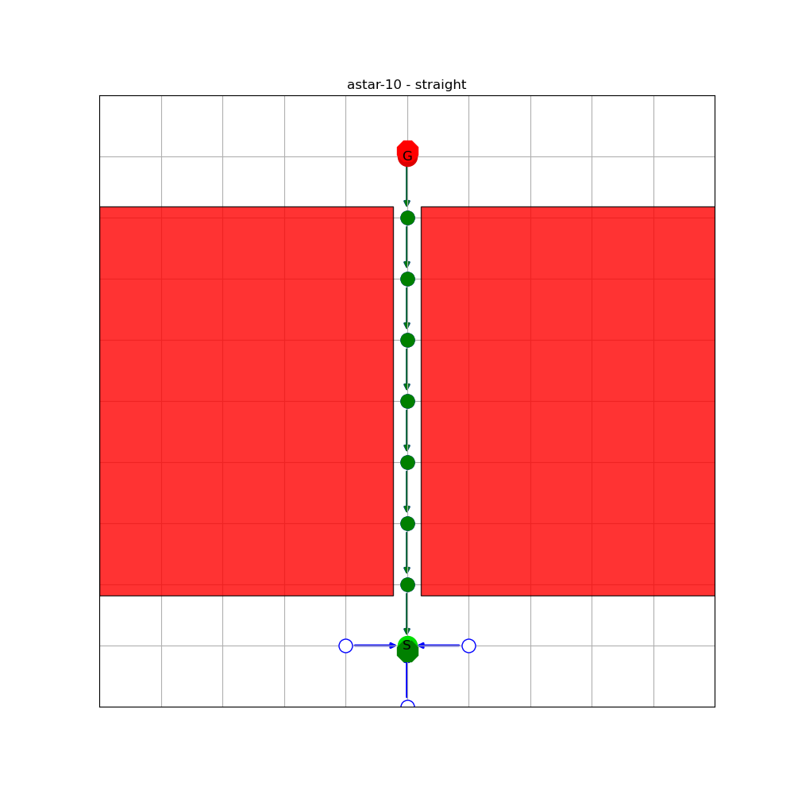
A* Discretization Comparision
Shorter paths with increasing costs
Environment depending
astar 10
astar 10

